Slide 1
Quasi-Passive Cyclic DAC
Gabor C. Temes
School of EECS
Oregon State University

Slide 2
Outline
Quasi-Passive Cyclic DAC
Operation
Capacitor Mismatch and Mismatch Compensation
Capacitor mismatch
Mismatch compensating switching
Spectrum shaping
Radix-based digital correction
Two-Capacitor DAC Enhancements
Time interleaved 2-C DACs
Pipelined quasi-passive cyclic DAC

Slide 3
Quasi-Passive Cyclic DAC
Operation:
Charge redistribution between two equal-valued capacitors
Serial digital input; LSB first
Φ₁ and Φ₂ are two non-overlapping clock phases
Conversion follows equation
DAC basic architecture
[1] R. E. Suarez et al., “All-MOS charge distribution analog-to-digital conversion techniques – Part II,” JSSC, Dec. 1975, pp. 379-385.
Conversion sequence for input ‘1101’
Notes:
Topright circuit shows the basic structure of 2-C DAC
Waveforms illustrate change of voltages across capacitors C1 and C2

Slide 4
Capacitor Mismatch
Capacitor mismatch effects
Conversion accuracy limited by capacitor matching
Capacitor mismatch introduces nonlinearity
Plots show performance degradation (bottom) in SNDR and SFDR compared with output spectrum from DAC with ideal matching (top)
Notes:
2¹⁴ point FFT

Slide 5
Mismatch Compensation (1)
Switching techniques
Compensative switching
The roles of the two capacitor is interchangeable
The roles of the capacitors can be chosen on bit-wise base
An algorithm was developed to minimize the conversion error for any digital word
The switching pattern is input dependent
First-order error canceled for 31% of the input codes; reduced to 1/10 for 48% of the input codes
The roles of the two capacitors are interchangeable with additional switches
[2] Weyten, L.; Audenaert, S., "Two-capacitor DAC with compensative switching," Electronics Letters , vol.31, no.17, pp.1435-1437, 17 Aug 1995.
Notes:
Note that not all input codes can be compensated.
Need only N cycles to convert

Slide 6
Mismatch Compensation (2)
Switching techniques
Complementary switching
Digital word fed to 2-C DAC twice; once with normal arrangement, once with swapped roles of C₁ and C₂
Output sof the two conversions are added (or averaged)
First-order mismatch compensated at cost of doubled conversion time
[3] Rombouts, P.; Weyten, L., "Linearity improvement for the switched-capacitor DAC," Electronics Letters , vol.32, no.4, pp.293-294, 15 Feb 1996.
Notes:
Need 2N cycles
Cancel only 1st order error, higher order error can be prominent when resolution is high

Slide 7
Mismatch Compensation (3)
Switching techniques
Input-word-splitting compensative switching
Compensative switching [2] does not compensate for all input codes
Split digital input into sum of two digital codes
The conversion errors need to be able to be respectively compensated using compensative switching for the two new digital inputs
Final output is the sum of the two conversions
Needs two sets of 2-C DACs
Needs analog summation
Needs sophisticated algorithm for splitting the input word
[4] Rombouts, P.; Weyten, L.; Raman, J.; Audenaert, S., "Capacitor mismatch compensation for the quasi-passive-switched-capacitor DAC," Circuits and Systems I: Fundamental Theory and Applications, IEEE Transactions on , vol.45, no.1, pp.68-71, Jan 1998.

Slide 8
Mismatch Compensation (4)
Switching techniques
Alternately complementary switching
Roles of C₁ and C₂ are swapped alternately in the first cycle and adopt complementary switching [3] for the second conversion cycle
Output of the two conversions are summed (or averaged)
INL improved due to cancellation of major second-order error
Hybrid switching
Averaging conversion results of complementary switching and alternately complementary switching
Smaller INL; fourfold conversion cycles
[5] Poki Chen; Ting-Chun Liu, "Switching Schemes for Reducing Capacitor Mismatch Sensitivity of Quasi-Passive Cyclic DAC," Circuits and Systems II: Express Briefs, IEEE Transactions on , vol.56, no.1, pp.26-30, Jan. 2009
Notes:
Paper shows a 3-fold average INL improvement for hybrid switching compared with complementary switching

Slide 9
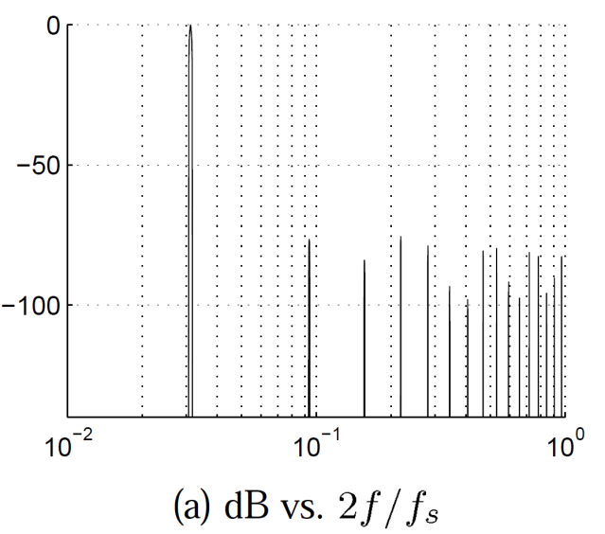
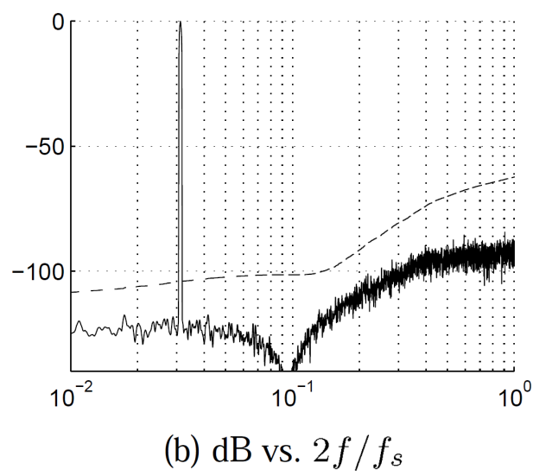
Mismatch Compensation (5)
Mismatch shaping
Using oversampling ΔΣ Modulator
Digital state machine to control switching sequence of a symmetric two-capacitor DAC
Improved linearity; better shaping for higher OSR
Needs 2N clock cycles for N-bit D/A
[6] Steensgaard, J.; Moon, U.-K.; Temes, G.C., "Mismatch-shaping serial digital-to-analog converter," Circuits and Systems, 1999. ISCAS '99. Proceedings of the 1999 IEEE International Symposium on , vol.2, no., pp.5-8 vol.2, Jul 1999
Simulated (FFT) performance of the DAC without (a) and with (b) mismatch shaping using a second-order loop filter

Slide 10
Mismatch Compensation (6)
Radix-Based Digital Correction
Compensation in digital domain
Effectively a radix-(C₁/C₂) conversion
Assumes known mismatch 2(C₁-C₂)/(C₁+C₂), or C₁/C₂
ADC-like algorithm predistorts digital input
Feeds predistorted digital words into the 2-C DAC
Better performance when DAC resolution is high
Need to find mismatch with high accuracy
Radix-based digital pre-distortion algorithm flowchart
DAC output spectra plots for (a) uncompensated condition, (b) alternately complementary switching, (c) radix-based algorithm and (d) radix-based algorithm with one extra bit.
Notes:
Need to arrange C₁ and C₂ in such a way that C₂, or the redistribution capacitor need to be the larger one. (conversion radix < 2)

Slide 11
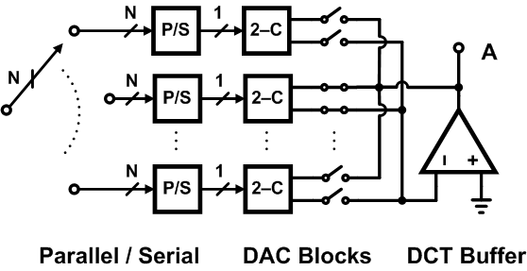
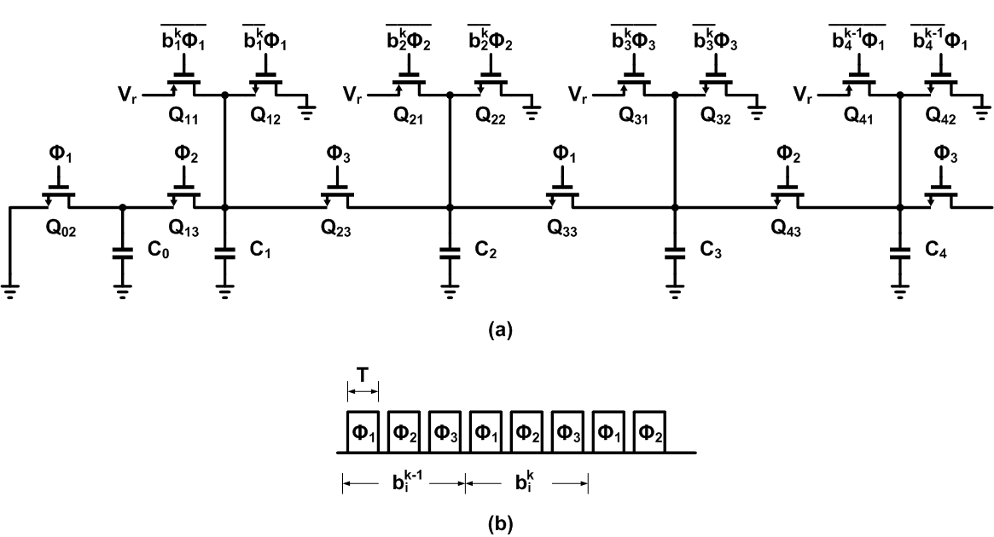
Two-Capacitor DAC Variations
Time interleaved 2-C DAC
Time interleaving 2-C blocks improves throughput speed
Capacitor mismatch among channels tolerable
Direct-charge-transfer buffer reduces power consumption
Pipelined quasi-passive cyclic DAC
Same operation as 2-C DAC
Information passed on to the last capacitor and DCT output buffer
[7] Wang, F.-J.; Temes, G.C.; Law, S., "A quasi-passive CMOS pipeline D/A converter," Solid-State Circuits, IEEE Journal of , vol.24, no.6, pp.1752-1755, Dec 1989
Notes:
More about the pipelined structure presented separately

